Slide 1
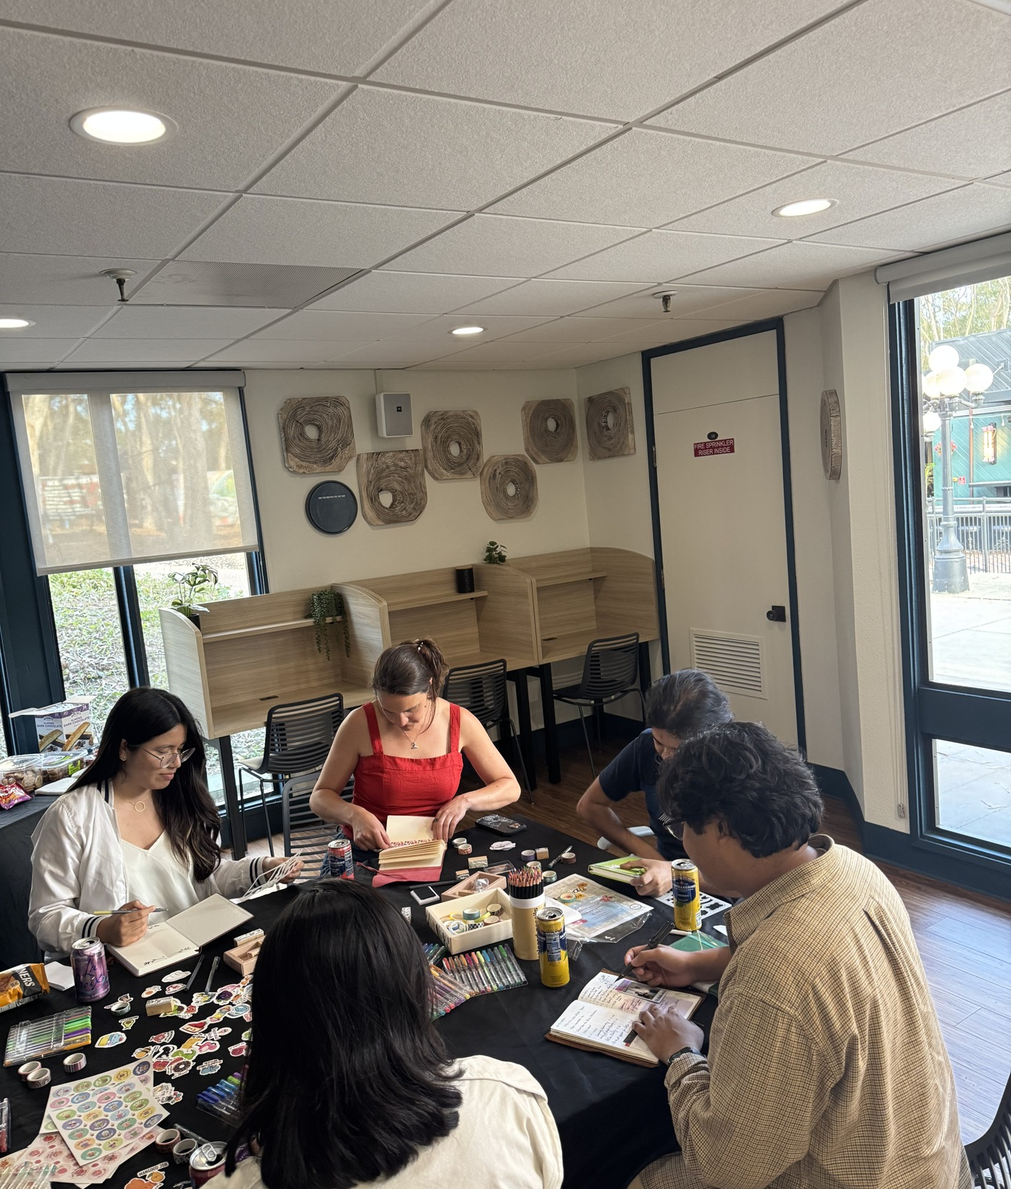

GRADUATE STUDENT LOUNGE
GPSA briefing on access, expectations, and shared stewardship
UC San Diego GPSA
May 2026
Notes:
Introduce the lounge as a graduate student third place with shared expectations, not a rulebook reading.

Slide 2
PURPOSE
Why the lounge exists
A visible graduate student home base keeps the space active, welcoming, and protected for graduate use.
Committee context
Meeting #1 focused on opening the lounge responsibly, setting terms of use, access process, cleaning expectations, and supplies.
A third place for studying, informal conversation, breaks, and community.
A commuter-friendly space to prepare food and store items short term.
A shared resource that must stay used, cared for, and clearly governed.
Why now
If the lounge is not opened to graduate students, campus may reclaim the space for another purpose.
Notes:
Emphasize the positive purpose first: active graduate use is the reason the lounge exists.

Slide 3
ACCESS
Who can use it and how
Eligible users
Agreement first
1
2
Currently enrolled UC San Diego graduate and professional students, plus registered graduate student organizations.
Users review and agree to the Terms of Use before access is granted.
Kuali request path
Credential check
3
4
The form may request general access, event use, or both. Each event needs its own request.
Users should carry a valid graduate or professional student ID while using the lounge.
Access is a privilege tied to stewardship, fairness, and safety.
Notes:
Keep this slide procedural: eligibility, agreement, form, credential. Avoid debating exact hours until confirmed.

Slide 4
EXPECTATIONS
The lounge works when everyone protects the vibe
Respect the room
Keep it flexible
Individual or small-group use. Keep calls outside or in the breezeway.
Projector use is first come, first served and should not monopolize the space.
Protect shared furniture
Post responsibly
Do not move large sofas, lamps, bookshelves, or fixed setup items.
Bulletin-board flyers should be dated, limited to standard paper size, and removed after 30 days.
Policy floor: no alcohol, no sleeping or living quarters, and no camping-style use.
Notes:
Use this as the culture slide: lively but respectful, active but not chaotic.

Slide 5
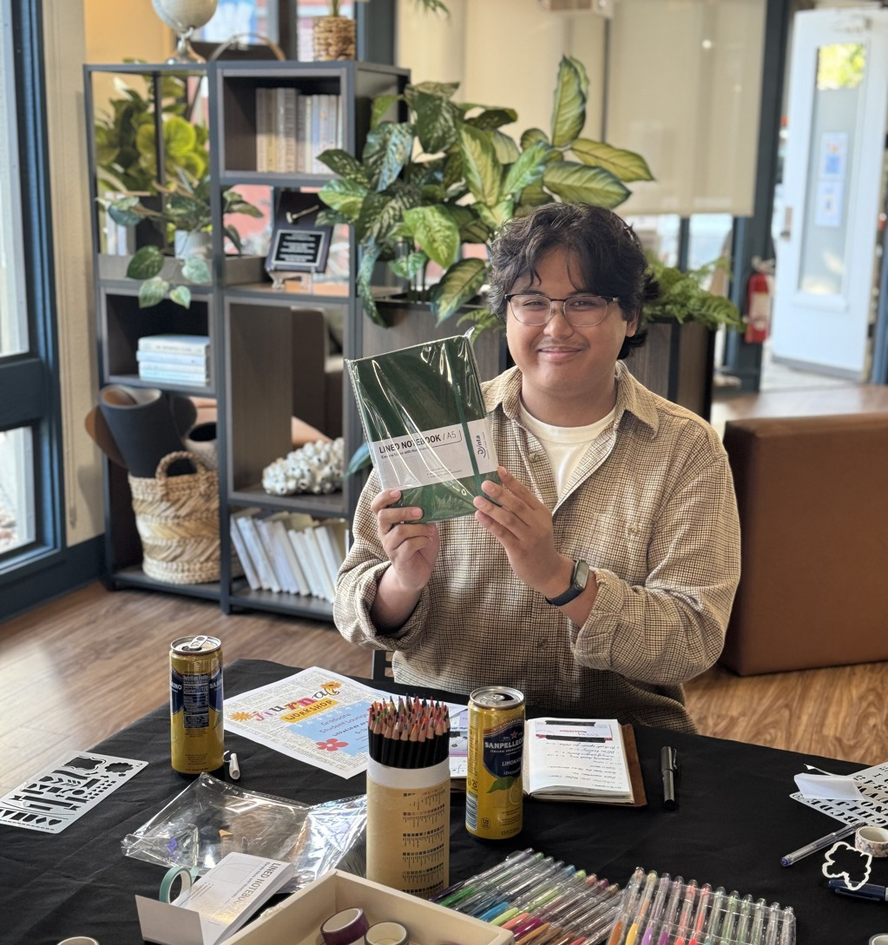
KITCHEN
Leave-no-trace is the operating rule
The kitchen supports commuters and community, but access depends on clean handoff to the next student.
Wash, dry, and put away reusable plates, mugs, and utensils.
Wipe counters, clean microwave spills, and report broken items by QR code.
Label fridge and freezer items with full name and date.
No grease, solid food, or foreign substances down the sink.
Fridge cleanout: every other Friday before 7pm, with reusable items moved to lost and found when feasible.
Notes:
The image here is about activity and supplies, not exhaustive inventory.

Slide 6
RESERVATIONS
Reservations should be visible and fair
Conference room baseline
Event use
Book up to two hours per day in 30-minute segments.
Submit a separate Kuali request for each reservation or event.
When unbooked, the room is first come, first served.
Approval can consider purpose, availability, history of rule compliance, and fair access.
Unattended items do not reserve a room.
Registered graduate student organizations share responsibility for cleanup and guest behavior.
Visible QR codes should point students to reservations, maintenance requests, and improvement suggestions.
Notes:
This slide frames the Kuali form as the key fairness mechanism.

Slide 7
SAFETY
Security rules protect access for everyone
Call path
Access can be removed for safety risks, security concerns, property damage, cleanliness problems, unauthorized entry, unapproved use, or repeated rule violations.
Emergency
Call 911.
Use your own access card or approved code only.
Library Safety & Security
Do not share access, prop doors, or bypass locks.
858-282-3602 for other concerns.
Written warnings may apply for less serious concerns; serious concerns can trigger immediate removal.
UC Campus Police
Individual access removal is permanent. Organization removal lasts at least one year.
858-534-4357 if there is no answer.
Notes:
Do not overstate surveillance details beyond the source. Mention CCTV only if asked verbally.

Slide 8
SHARED UPKEEP
Supplies make the lounge useful only if they stay organized
Kitchen basics
Clean setup
Community extras
Coffee maker, water dispenser, tea, coffee, creamer, sweeteners, dish soap, sponges
Napkins, plates, cups, utensils, trash bags, paper towels, disinfecting wipes or spray
Board games, mindfulness activities, exam supplies, study supplies, bulletin-board materials
Operating principle
Use what you need, return what you use, and report what is missing before the lounge quietly runs down.
Potential next step: decide whether rotating department representatives, executive follow-up, or a paid lounge manager owns recurring checks.
Notes:
Use this slide to move from inventory to ownership. Supplies without upkeep are not a system.

Slide 9
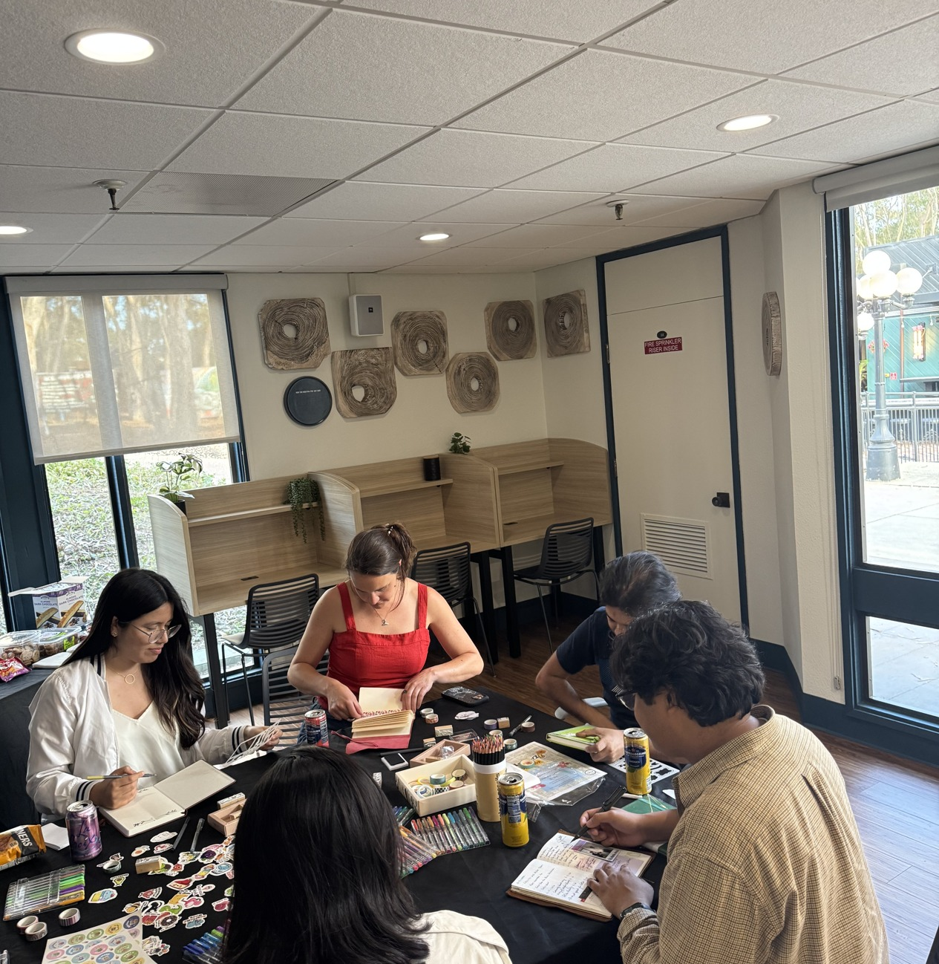
VISION
A graduate third place, not just a room
The goal is a space that feels active enough to matter and cared for enough to last.
Welcoming to all graduate and professional students.
Clear enough for fair access and safe events.
Flexible enough for study, food, conversation, and student life.
Sustainable because upkeep is shared and visible.
Notes:
Return to the core frame: governance should preserve the third-place feeling, not smother it.

Slide 10
Confirm hours
Regular, finals, summer, and holiday access need final decisions.
Questions and feedback
Confirm owner
What needs to be clearer before the lounge opens to graduate students?
Name the administrator for approvals, warnings, and restoration requests.
Confirm upkeep
Decide who checks fridge, supplies, QR requests, and recurring cleaning gaps.
AI Use Disclosure
Prepared with GPT-5 via the Claudia agent system for summarizing, structuring, and formatting this GPSA briefing deck. Edgar should review all policy language, operational details, and final decisions before sharing.
Internal provenance: Generated for Edgar Agunias | Date: 2026-05-04 | Sources: Grad Lounge Committee Meeting #1.md, selected lounge photos IMG_3581 and IMG_3585, Standard PowerPoint Template | Agent: Hephaestus
Notes:
Close by asking for final policy decisions and review comments. The disclosure is included because the deck is an agent deliverable.

